Slide 1
OSCE Answer
11/2016 PWH

Slide 2
Question 1
49 years old gentleman presented with low back pain for 6 months. He has no history of injury. He denied urinary and gastro-intestinal symptoms.
X-ray LS spine was performed

Slide 3
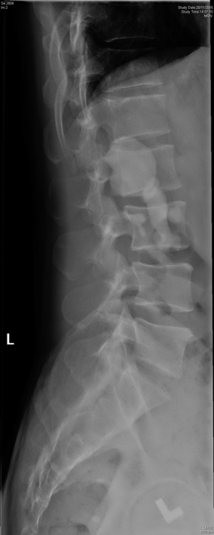
Question 1

Slide 4
Describe the X-ray. What is the diagnosis?
A large radio-opaque lesion is seen projected over right renal shadow. Tiny opacities are projected over the inferior aspect of left renal shadow
Staghorn calculi are branched stones that occupy a large portion of the collecting system

Slide 5
What are the commonest components of the stone?
approximately 75% are composed of a struvite-carbonate-apatite matrix.
Struvite is magnesium ammonium phosphate

Slide 6
Name the associated common organism for the formation of stone
recurrent urinary tract infection with urease producing bacteria (e.g. Proteus, Klebsiella, Pseudomonas and Enterobacter).
Urease hydrolyses urea to ammonium and increase in the urinary pH, promote crystallization of magnesium ammonium phosphate (struvite), leading to formation of large, branched stones.

Slide 7
What is the best definitive treatment?
Depends on the patient/disease factors,
In term of stone free rate, complications, recurrence
Percutaneous Nephrolithotomy (78%)
Shock-wave Lithotripsy (54%)

Slide 8
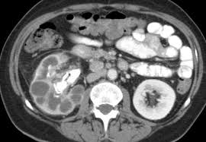
What is the long term complication if the stone is left untreated?
Xanthogranulomatous pyelonephritis
a chronic granulomatous process believed to be the result of subacute/chronic infection inciting a chronic but incomplete immune reaction. The kidney is eventually replaced by a mass of reactive tissue

Slide 9
Question 2

Slide 10
Question 2
53 years old cleaner worker complained of right intense deep burning hand pain at the midnight.
He cleaned the swimming pool in the morning. The patient is fully conscious with stable vital sign.

Slide 11
Describe the picture
A white discoloration with mild erythema and minimal edema
Bluish discoloration over the nail
No ulceration / necrosis
What is the suspected culprit?
hydrofluoric acid

Slide 12
What is the mechanism of the injury?
At concentrations >50%, HF acidity increases dramatically and it then behaves like a strong acid
more significant mechanism of tissue destruction is caused by fluoride ions.
as the most electronegative element on the periodic table, free fluoride ions (F⁻) avidly bind available cations, the most physiologically important being calcium and magnesium
localized hyperkalemia, neuronal depolarization and intense pain

Slide 14
What are the life threatening complications?
cardiac arrhythmias due to mainly hypocalcemia – but also hypomagnesemia, acidosis, fluorosis and hyperkalemia
ECG – prolonged QTc

Slide 15
What are the treatment options?
ABC
Treat life-threatening arrhythmia IV calcium gluconate, correction of hyperkalaemia
Local injury
Topic calcium gel
Intradermal/Subcutaneous injection calcium gluconate
Localized intravenous calcium administration (Bier block)
Intra-arterial calcium gluconate

Slide 16
Question 3
45 year old man was bitten by a snake at home 30 minutes ago. He came to A&E with the snake.
Blood pressure was 145/85, Pulse was 90bpm, SpO₂ was 99%. RR was 16.
On examination, the patient was not in distress. There was fang mark over the right hand.
There was no gross swelling / bruising.

Slide 18
Describe the snake. What is the common name of this snake?
alternating black and white crossbands, black bands being wider
Triangular body
Short, thin tail tapering towards the end
Bungarus multicinctus
Common name:
Many banded krait, Narrow banded krait, 銀腳帶

Slide 19
What kind of toxicity would you anticipate?
Bungarotoxins
α-Bungarotoxin
β-Bungarotoxin
γ-Bungarotoxin
k-Bungarotoxin
Act at the NMJ (both pre-synatic and post synatic)
Neurotoxicity, respiratory paralysis

Slide 20
List 2 initial symptoms / physical signs that you will look for, in order to watch out for deterioration?
Ptosis
Diplopia, opthalmoplegia
Peak flow rate, vital capacity

Slide 21
What antivenom will you consider? Will you consider give anti-venom if the patient does not have any symptom? Why ?

Slide 22
Consider prophylactic administration of 2 vials of antivenom, repeated dose of antivenoms may be needed if neurotoxic sign developed
Early administration is critical for success
Antivenom cannot neutralise bound venom, and can be effective only if given early enough to neutralise circulating venom before it binds to target sites

Slide 23
List 1 important complication in giving the treatment you suggested? Suggest 2 pretreatments to reduce the risk of such complication
Anaphylaxis, allergic reaction
Pretreatment with piriton and hydrocortisone
Standby adrenaline

Slide 24
The Pharmacy told you that the treatment you suggested was not immediately available and the patient developed ptosis in A&E, what medical treatment that can be helpful in order to buy time?
Edrophonium chloride 10 mg with atropine 0.6 mg may be tried for elapidae venom induced paralysis
Neostigmine may be used if edrophonium is effective

Slide 25
Question 4
33 years old female, unremarkable past health, underwent IVF and had embryo transfer 10 days ago.
She cmplained of abdominal distension and SOB for 2 days.
Ultrasound images were obtained (Right coronal scans)

Slide 28
Describe the ultrasound findings
Anechoic fluid collections in Morrison's Pouch and Right costophrenic angle, suggesting ascites and pleural effusion respectively.
What would be the expected ultrasonic finding(s) of the ovaries in this patient?
Ultrasound examination will usually show ovaries 10 to 12 cm in diameter filled with multiple luteal cysts

Slide 29
From Radiopaedia.org

Slide 30
What is the most likely diagnosis ?
Ovarian hyperstimulation syndrome
Name 3 risk factors of the disease
Several factors independently increase the risk of developing severe OHSS. These include the following:
Age < 30 years
Polycystic ovaries or high basal antral follicle count on ultrasound
Rapidly rising or high serum estradiol
Previous history of OHSS
Large number of small follicles (8 to 12 mm) seen on ultrasound during ovarian stimulation
Use of hCG as opposed to progesterone for luteal phase support after IVF
Large number of oocytes retrieved (> 20)
Early pregnancy

Slide 31
Can you describe the pathophysiology leading to the diagnosis you mentioned in Q3 ?
a systemic condition thought to result from vasoactive peptides released from the granulosa cells in hyperstimulated ovaries
an increase in capillary permeability resulting in a fluid shift from the intravascular space to third space compartments
hCG has been shown to increase VEGF expression in human granulosa cells, which in turn raises serum VEGF concentration. Other mediators, such as angiotensin II, insulin-like growth factor 1, and interleukin-6, have also been implicated in the disease process.

Slide 32
Why is pelvic examination contraindicated in this patient ?
Caution should be taken with pelvic examinations to minimize the risk of trauma to enlarged ovaries.

Slide 33
List 3 complications of the disease
Ovarian torsion
Renal failure, thromboembolism, pericardial effusion, and adult respiratory distress syndrome are potential life-threatening complications of OHSS

Slide 34
Question 5
50 years old gentlemen presented to A&E for sore throat and fever for 2 day.
He complained of odynophagia. Denied history of foreign body ingestion
P/E
Temp 38.2
Swelling over the neck and mandible
BP 165/67 P 122 SpO2 96% RA

Slide 36
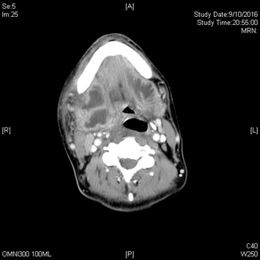
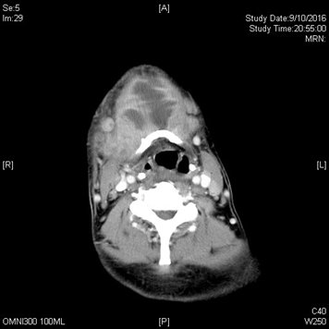

Slide 37
Describe the X-ray
Soft tissue swelling over the submandibular region , fullness over the vallecular, no FB / retropharyngeal soft tissue swelling
Describe the CT scan
large rim-enhancing abscess centered in the right tonsillar region. Extensive extension into right submandibular and sublingual spaces, crosses the midline to involve the left sublingual and submandibular spaces.
Bilateral submandibular glands are swollen and likely involved by the abscess.

Slide 38
What is your clinical diagnosis ? List 3 ddx
Ludwig angina
Tonsillitis +/- Quinsy
Retropharyngeal abscess
Epiglottitis
Foreign body aspiration
Cervical lymphadenitis
Thyroiditis
Dental infections or abscesses

Slide 39
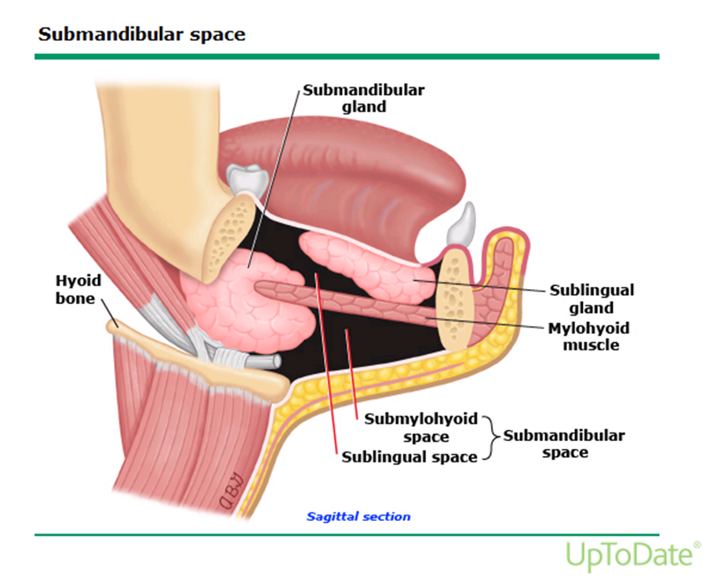
Anatomical space
sublingual space superiorly and the submaxillary space inferiorly

Slide 40
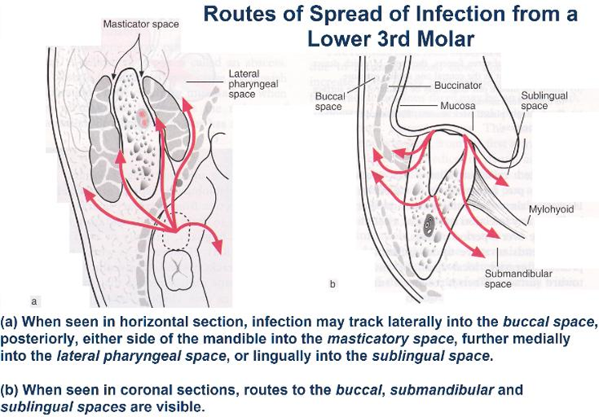
3 anatomical space
Perimandibular spaces
sublingual, submental and submandibular space

Slide 41
What is the most frequent source of infection ? List 2 more
Over two-thirds of patients with Ludwig’s angina have a dental source of infection, usually involving the second or third mandibular molar teeth
Other sources of infection include contiguous spread from peritonsillar abscess or suppurative parotitis

Slide 42
Common organism
Polymicrobial infection occurs in over 50% of cases.
The most commonly cultured organisms include Staphylococcus, Streptococcus, and Bacteroides species

Slide 44
High risk group
diabetes mellitus, alcoholism, acute glomerulonephritis, systemic lupus erythematosus, aplastic anemia, neutropenia, and dermatomyositis

Slide 45
X-ray

Slide 46
Complications
Air compromise
Mediastinitis
thrombosis of the internal jugular vein
erosion into the carotid artery
spontaneous abscess rupture leading to asphyxia, aspiration or pneumonia,
septicemia,
empyema
Pericarditis
Meningitis

Slide 47
Lemierre’s syndrome is characterised by disseminated abscesses and thrombophlebitis of the internal jugular vein after infection of the oropharynx.
The predominant pathogen is a gram-negative anaerobic bacillus, Fusobacterium necrophorum

Slide 48
Question 6
61 years old, chronic drinker, complained of sudden onset of chest pain, radiated to back.
The pain was associated with sweating and vomiting.
BP L 90/65 R 89/62 P 120 SpO2 96% 2L
ECG showed sinus tachycardia

Slide 50
Describe the CXR:
Surgical emphysema, increase haziness over the Left lower zone
What is your diagnosis? What is the name of classical triad?
Boerhaave syndrome
Mackler triad: vomiting, lower thoracic pain, subcutaneous emphysema

Slide 52
Describe the CT
Bilateral pleural effusion, atelectasis over the left lung
Left pneumothorax
Pneumomediastinum

Slide 53
What is the A&E management?
aggressive resuscitation
Consider insertion of chest drain
Consult surgery for early surgical intervention
Consult ICU for haemodynamical support
IV broad-spectrum antibiotics

